Slide 1
Welcome!
Electrical/Firmware Training Week 0

Slide 2
Instructor Introductions
Who are we?

Slide 3


Electrical Trainers
Jackie Mac Hale (RoboRacing, CmpE)
Bernardo Perez (RoboCup, EE)

Slide 4

Firmware Trainers
Andrew Roach (RoboNav, Math / CS)

Slide 5
Disciplines
What’s the difference?

Slide 6
Electrical
What we do?
Develop PCBs to integrate components (sensors, motors, etc), assemble and test them
System design (power, wiring, safety systems)
What you learn in Electrical Training?
Electrical components and common circuits
Prototyping
Printed Circuit Board (PCB) design using EAGLE
Debugging circuits and soldering

Slide 7
Firmware
What we do
Writes the code to run on PCBs that electrical designs
Implements the low-level functionality for software
What you learn in Firmware Training
Electrical components and common circuits
Prototyping
Microcontroller programming
Communication Protocols
Debugging circuits and soldering

Slide 8
Software
What we do
Write code that runs (mostly) on “regular” computers
“Autonomy”: Vision, motion planning, decision making, etc.
A little bit of motion control (split between SW/FW teams)
What you learn in Software Training
Basics of C++ and ROS
Robotics concepts for autonomy

Slide 9
Logistics
How will this work?

Slide 10
Electrical/Firmware Training
Two sessions a week
Monday and Wednesday 6:30pm - 8:00pm
Only need to come to one a week

Slide 11
Weekly Plan
Week | Electrical Training | Firmware Training
0 | Introductions, Electrical Basics
1 | Introduction to Prototyping and Arduino
2 | KiCad Parts and Libraries | More C and Interrupts
3 | KiCad Schematics | PWM and Bitwise Operations
4 | KiCad Board Layout | Communication Protocols
5 | Debugging and Soldering

Slide 12
Online Platforms
GitHub - Slides and Labs
github.com/robojackets/electrical-training
Slack – RoboJackets Team Communication

Slide 13
Important Slack Channels
Join:
#<team> (i.e. #robocup)
#<team>-electrical (i.e. #robocup-electrical)
#electrical-firmware-training-helpdesk (announcements and Q&A for electrica/firmware training)
#electrical-core (electrical/firmware collaboration)
#electrical-ama (electrical/firmware questions)
#pixie-wranglers (memes/off-topic)
Set profile picture / “What I do” (<team> Electrical)
Other channels: #rj-girl-gang #research #lets-meet-up

Slide 14
Team Introductions
We build robots!

Slide 15
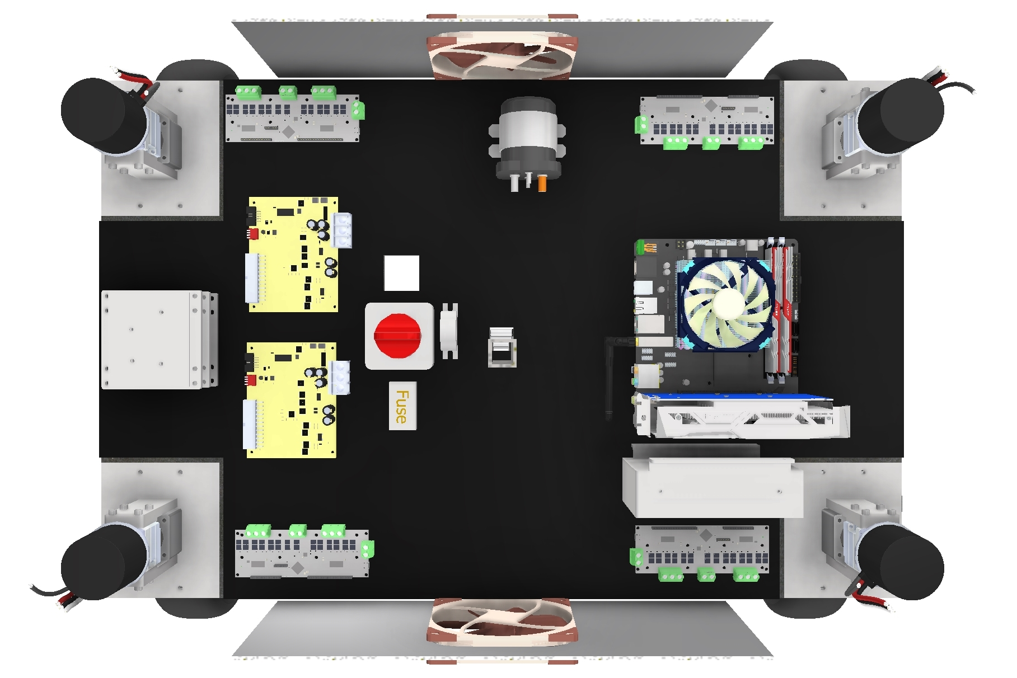
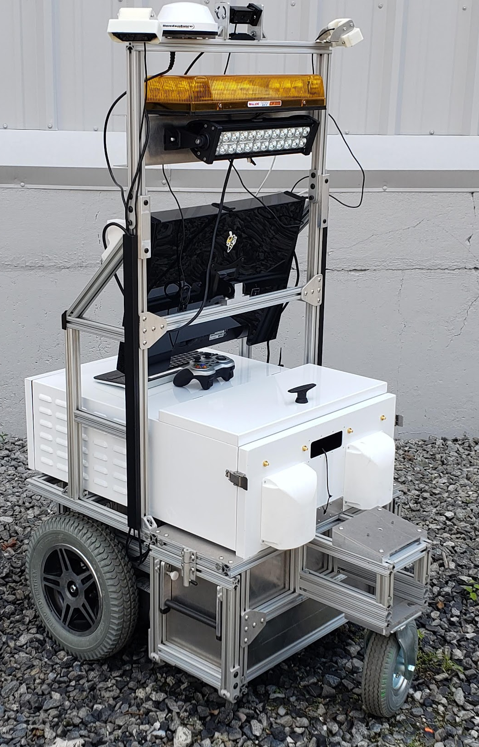
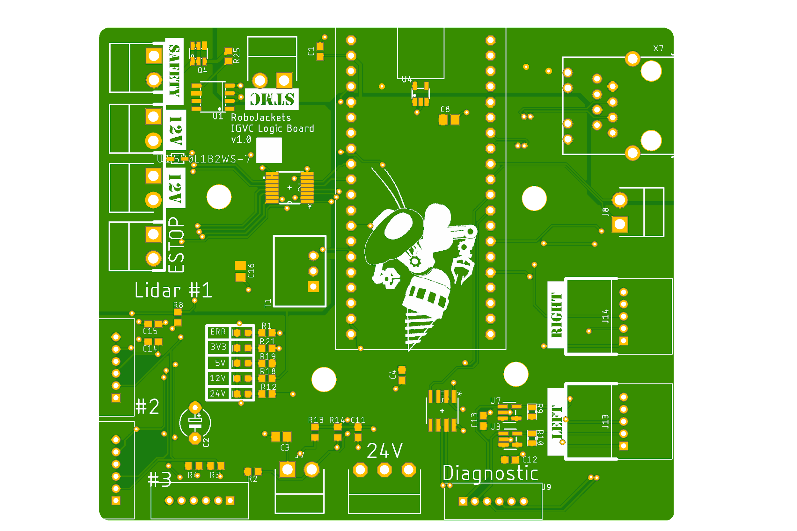
RoboNav
Weatherproof Electronics
Multi-threaded Firmware

Slide 16
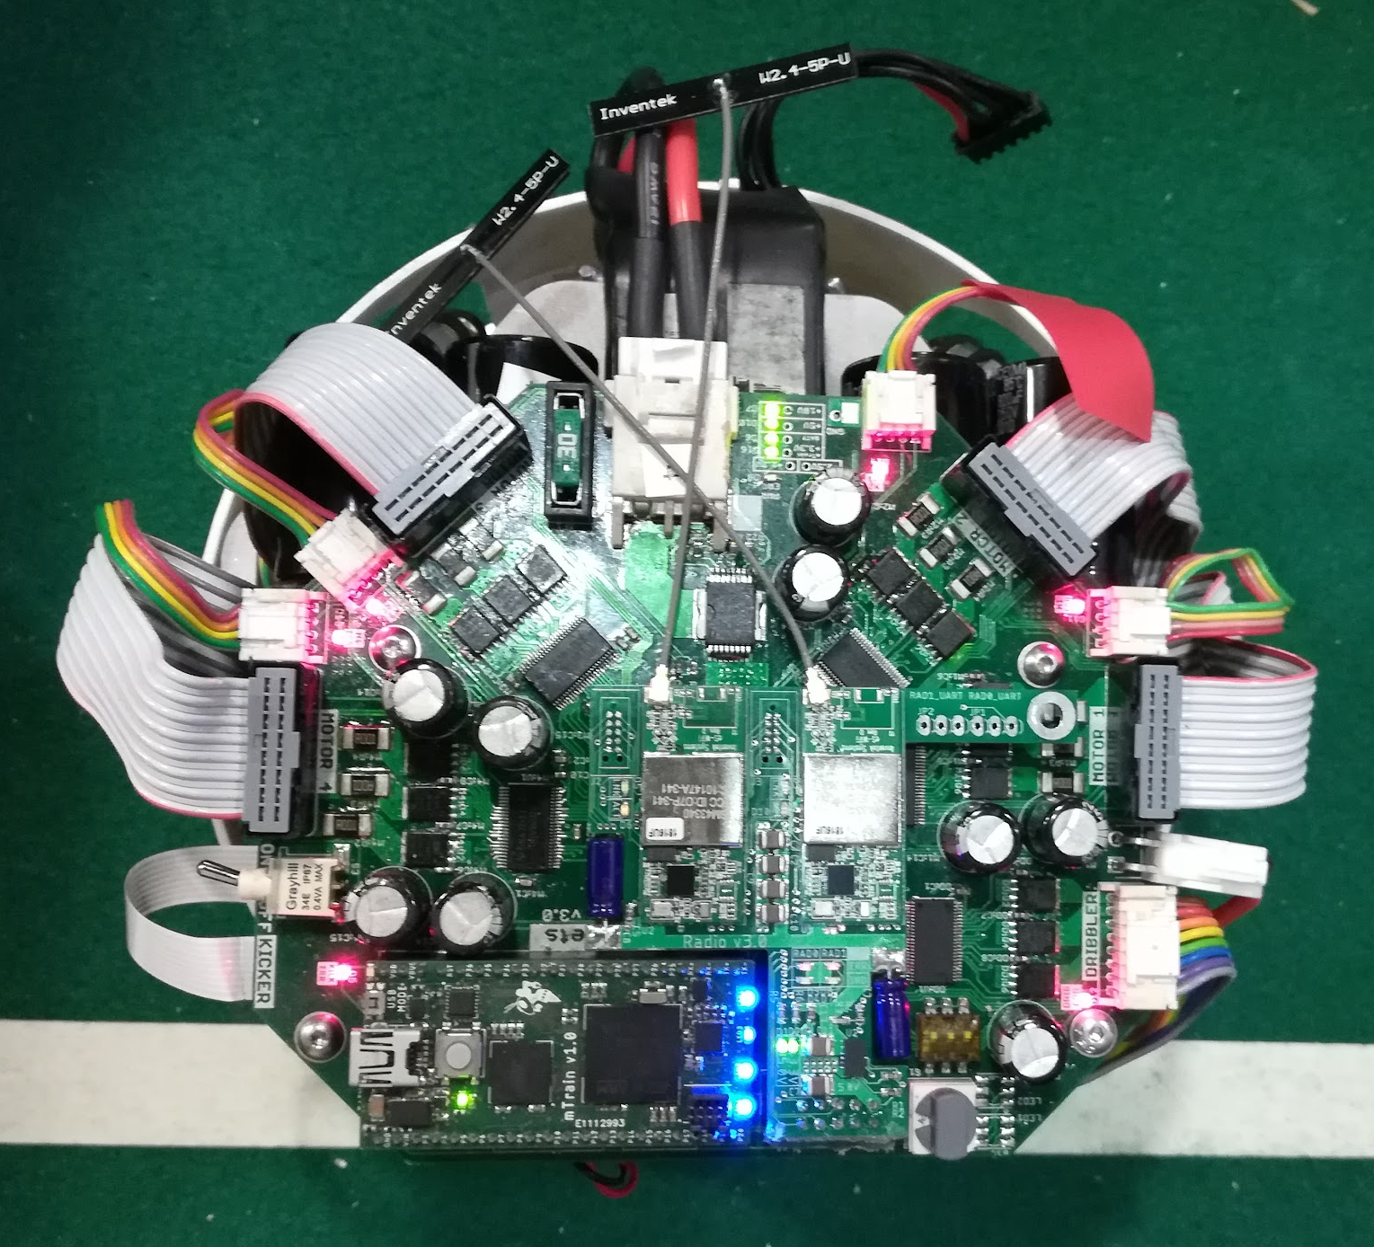
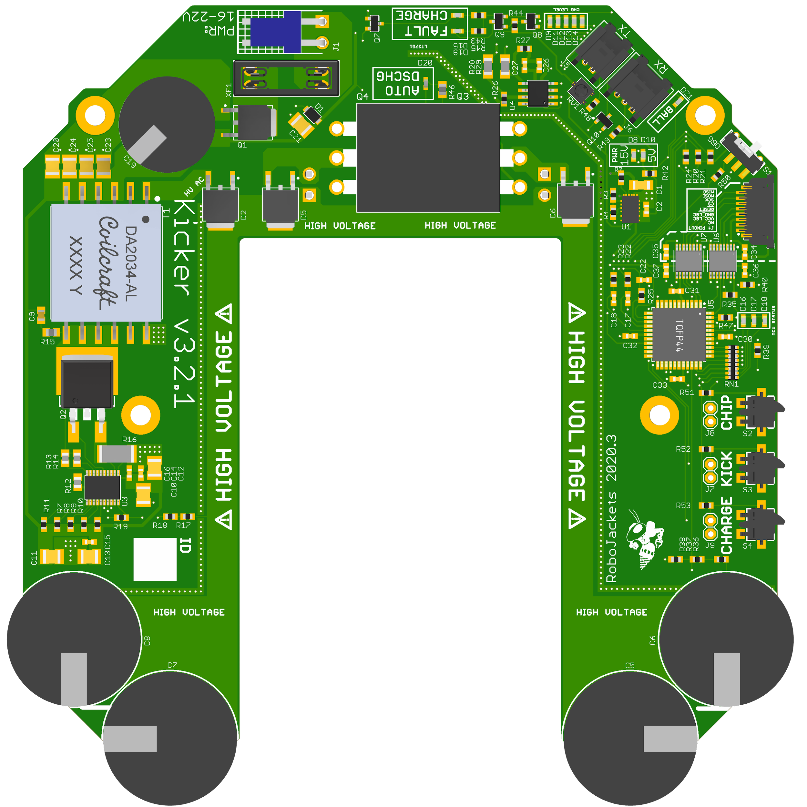
RoboCup
Power Electronics
FPGA-based Motor Control

Slide 17
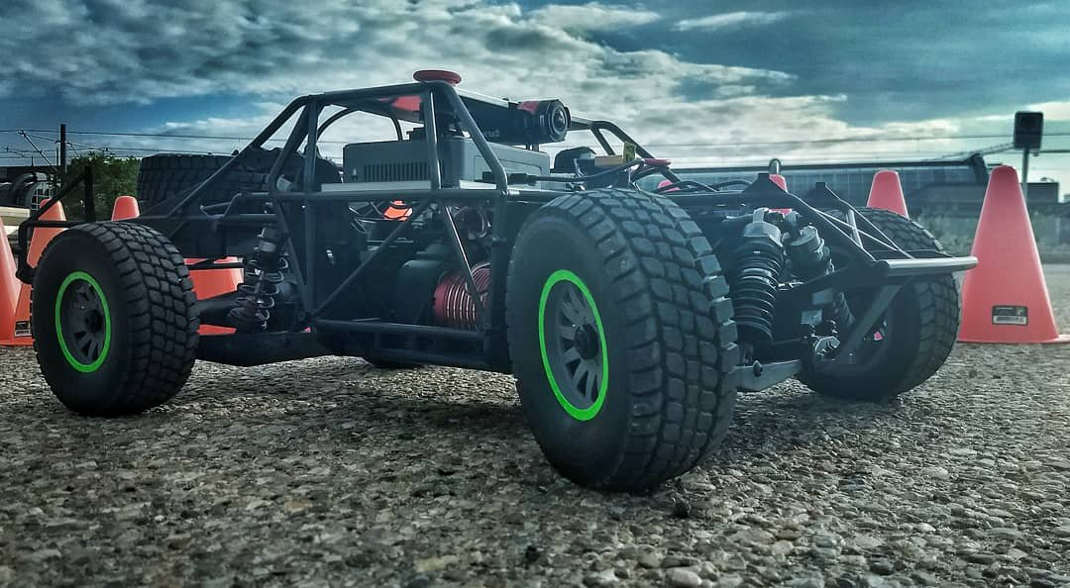
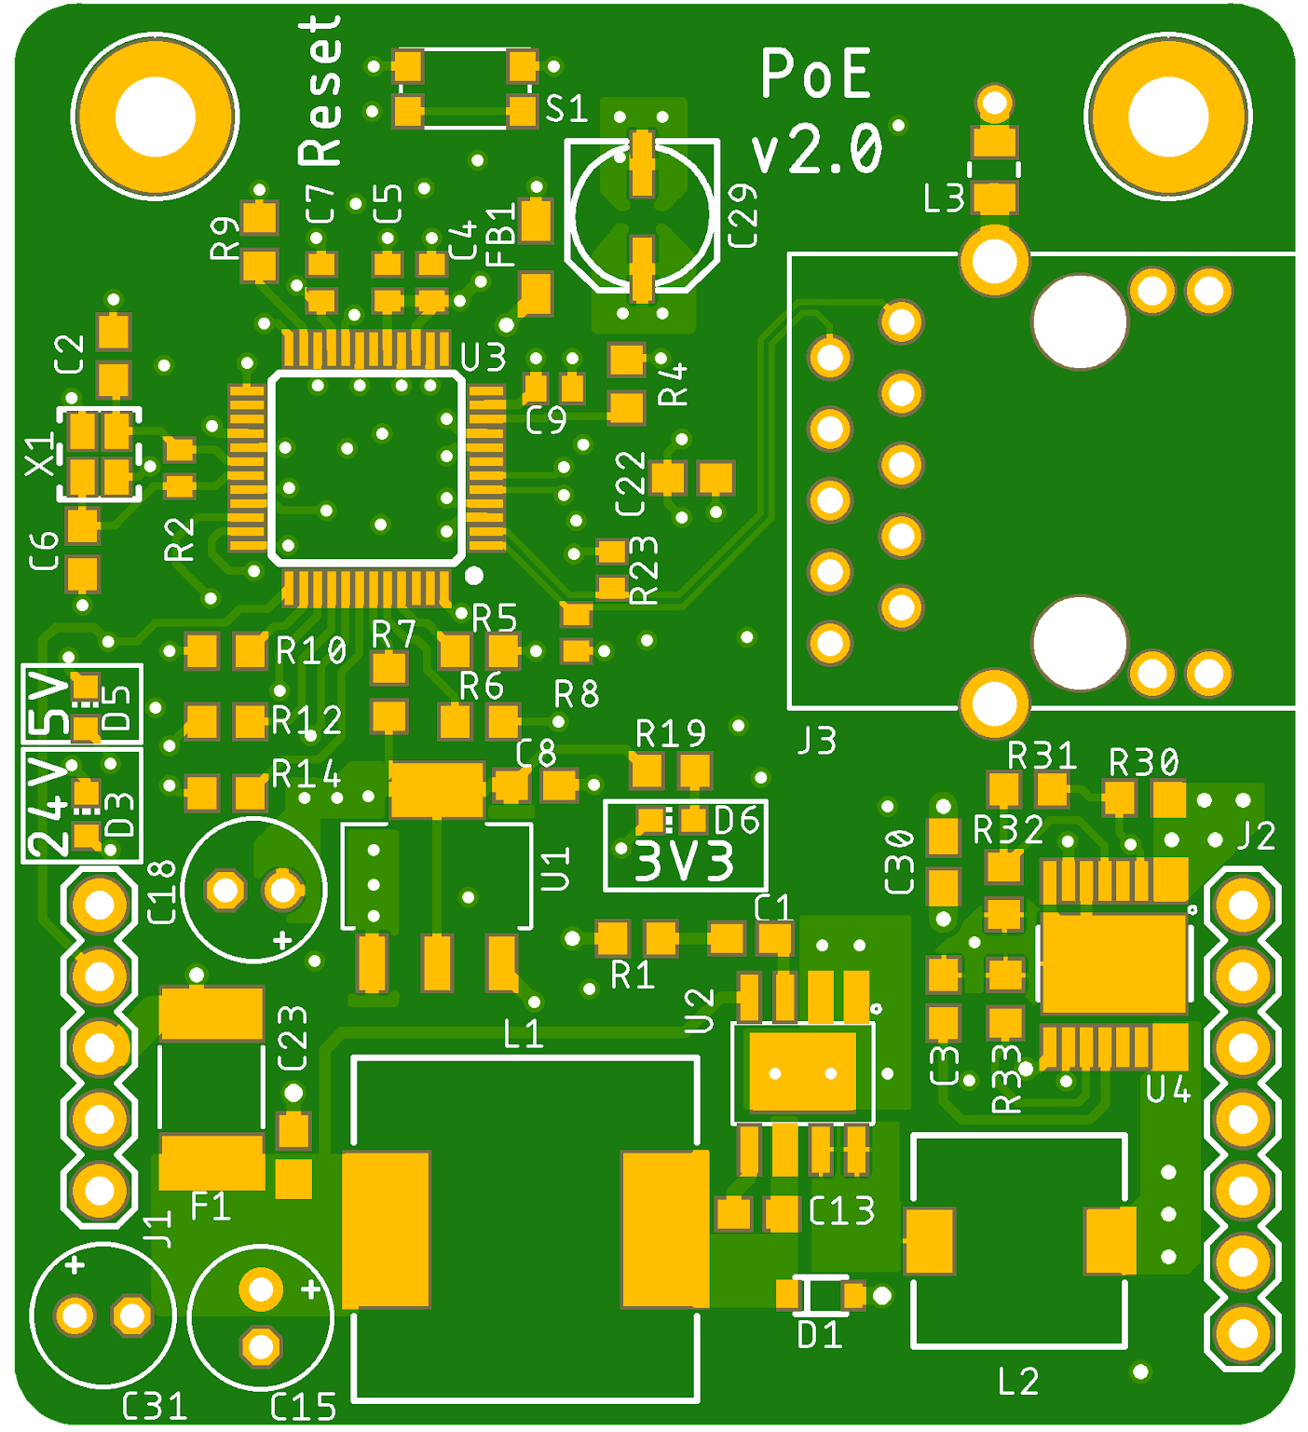
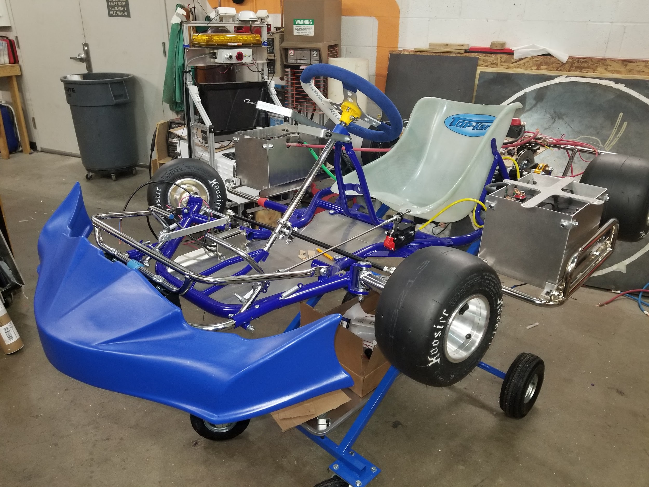
RoboRacing
Distributed Network Systems
High Speed and Power

Slide 18
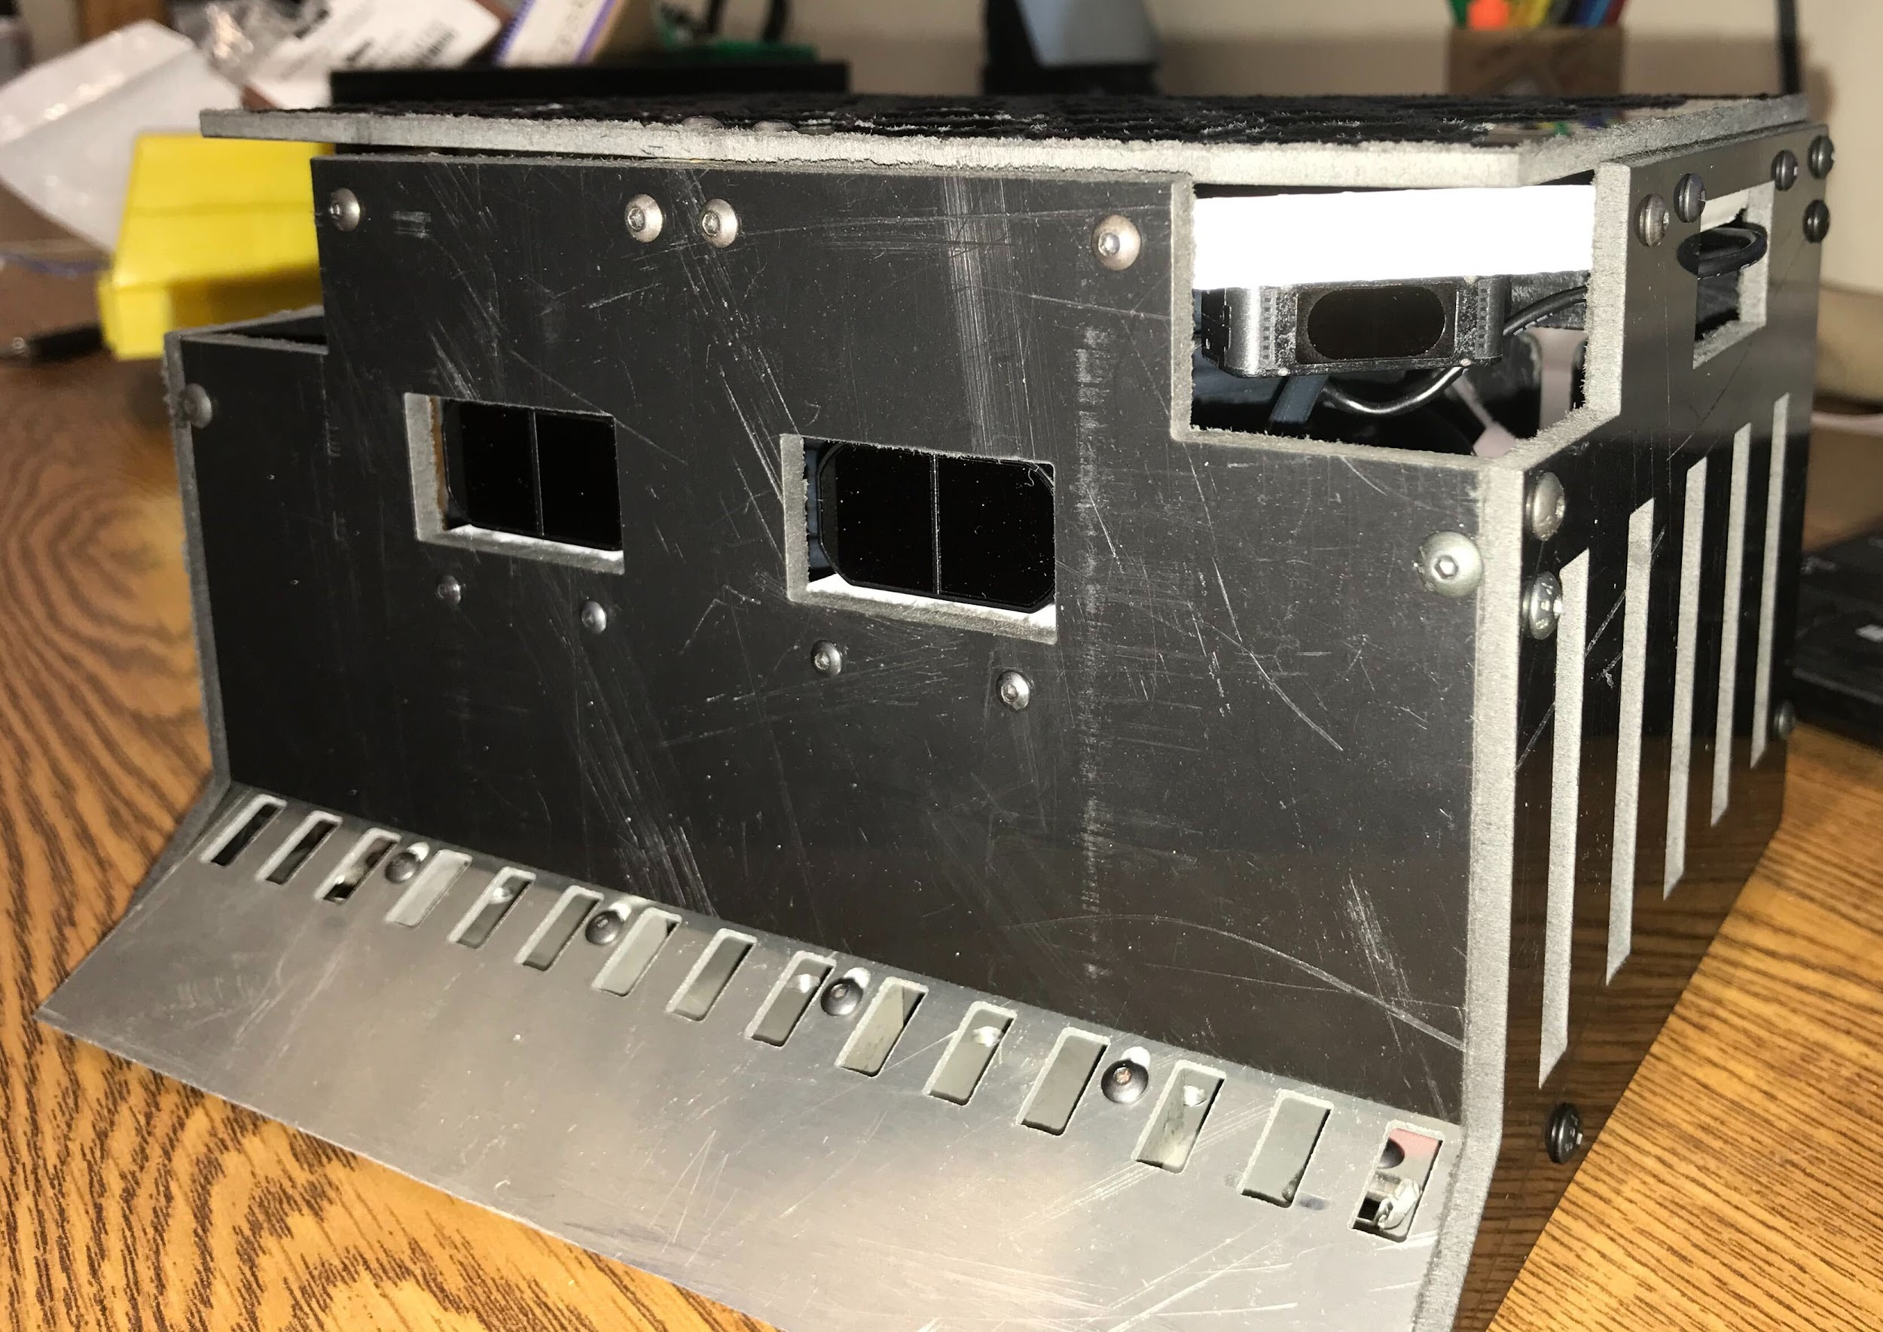
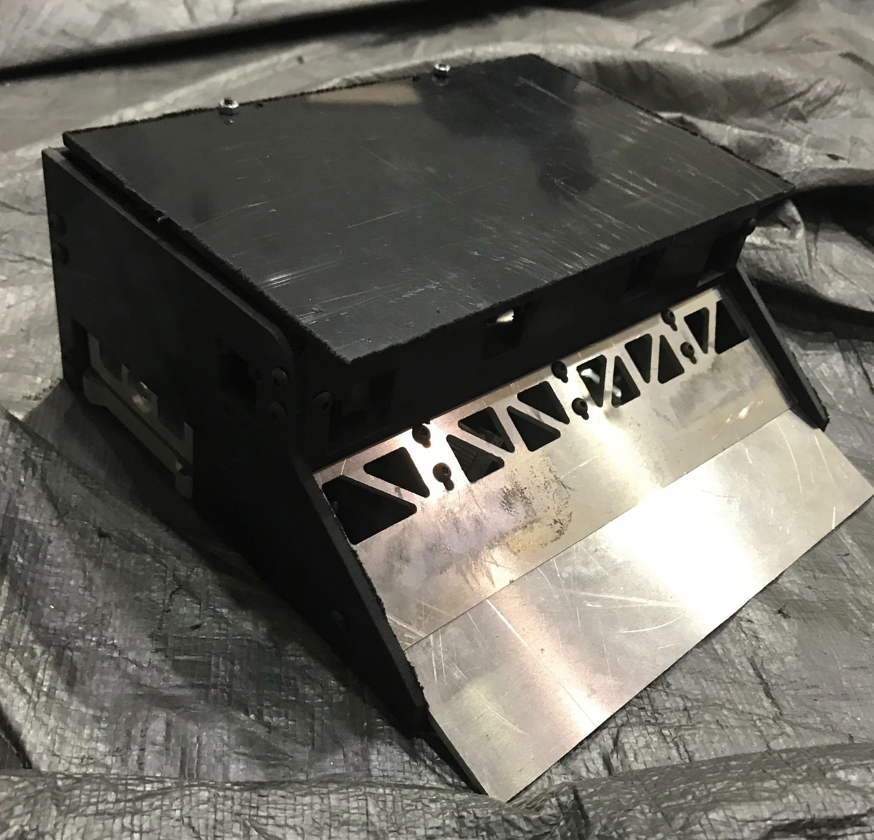
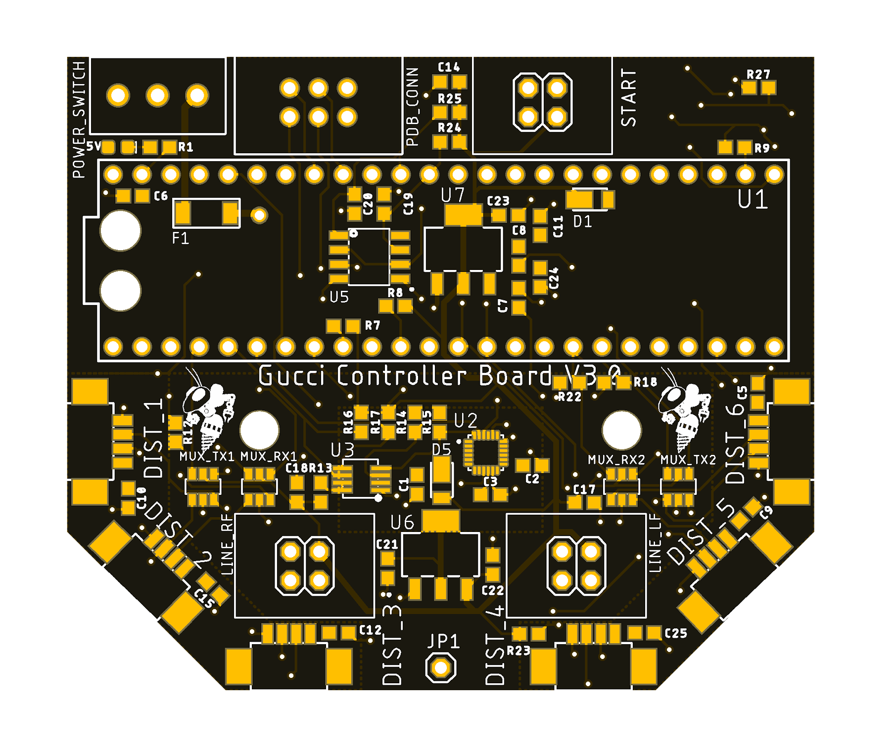
RoboWrestling
Real-Time Strategy
Small Packaging

Slide 19
Robotics

Slide 20
What is a Robot?
Actuators
Decision
Robot
Environment
Sensors

Slide 21
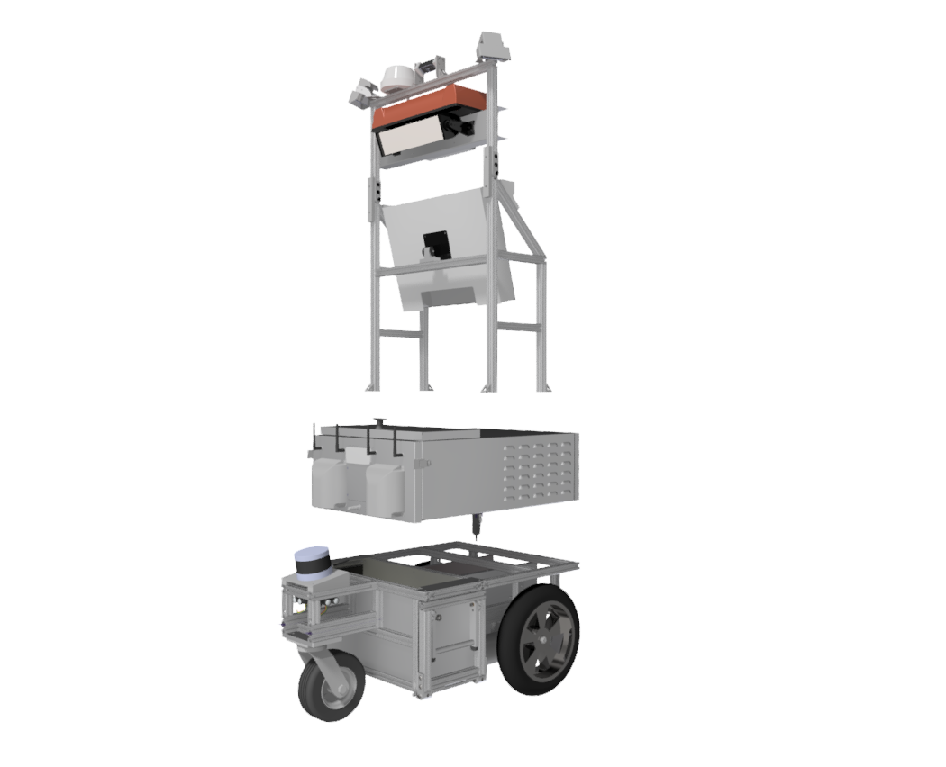
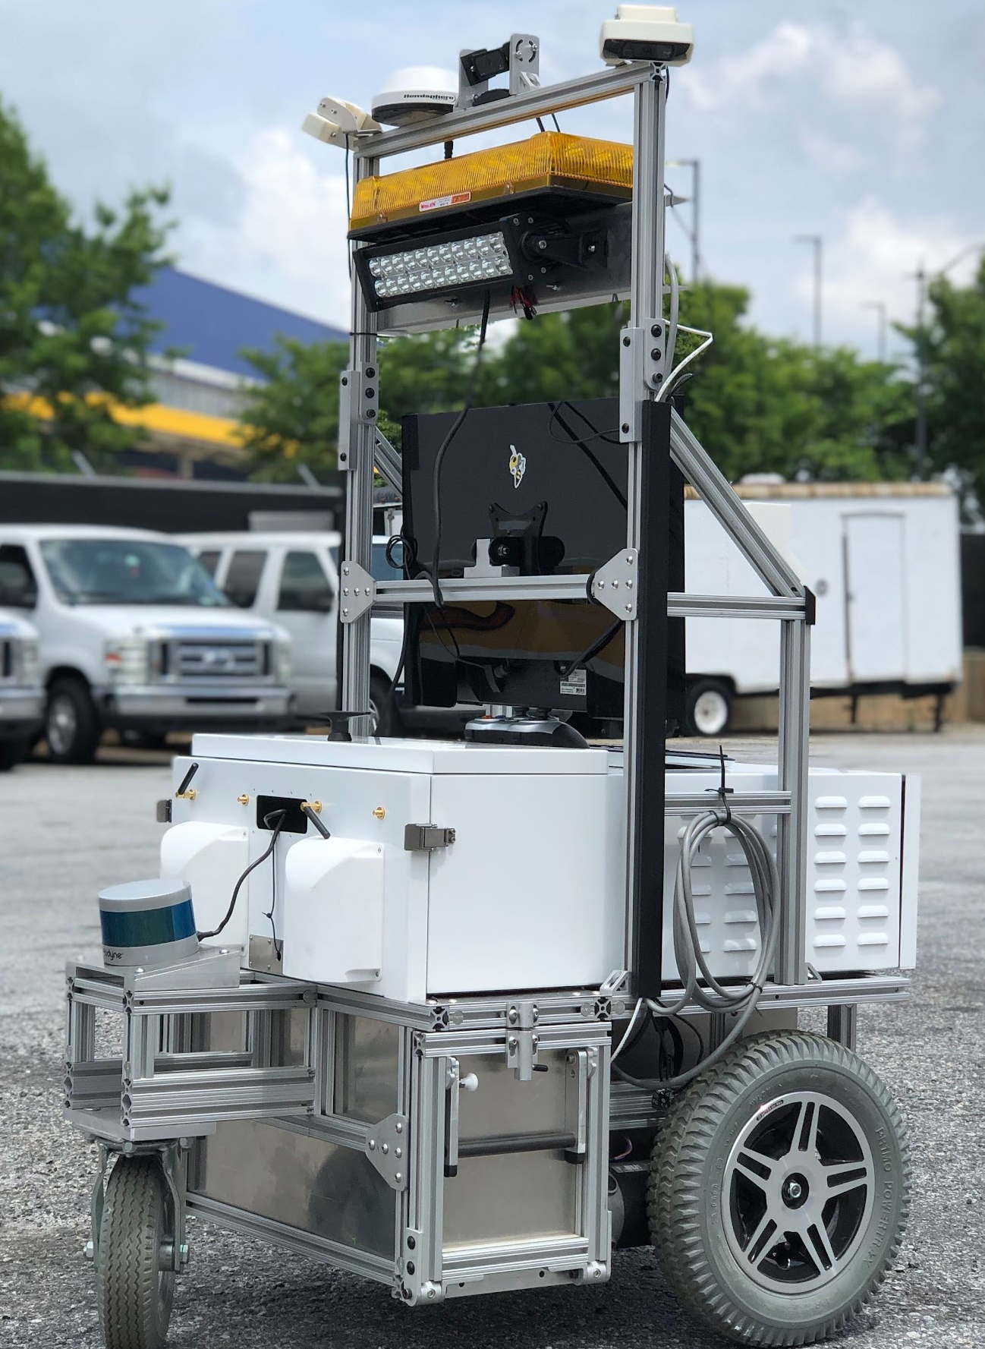
Cameras, GPS
Mast
Monitor
Computer & Control Electronics
Electronics Tray
Batteries, LiDAR, & Drivetrain
Chassis

Slide 22
Sensors
Decision Making
Actuators
Information
Commands
LiDAR
Inertial Measurement Unit
Cameras
Wheel Encoders
Custom-built Computer
Mbed Microcontroller
2x Brushed DC Motors

Slide 23
Electricity Basics
Electrons go brrrr

Slide 24
What is electricity?
Movement of charged particles (electrons)
Voltage: Amount of potential energy in electrons (J/C)
Current: Rate at which electrons flow (C/s)
Current flows from high potential to low potential, releasing energy

Slide 25
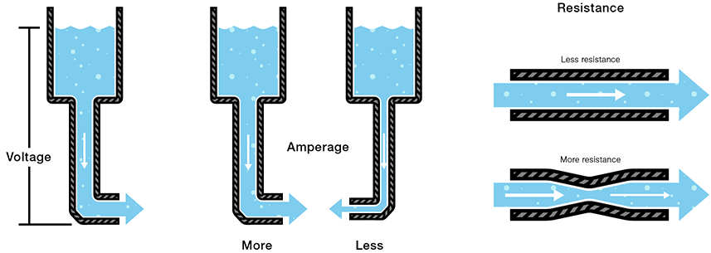
Water Analogy

Slide 26
V_{CC}/V_{DD} and GND
V_{CC}/V_{DD} is often used to represent a power voltage
GND is used to represent ground
Reference voltage for 0 Volts
Notes:
Vcc / Vee is older terminology. CC stands for “common collector”, EE stands for “emitter”. Vdd / Vss is newer terminology. DD stands for “drain”, SS stands for “source”.
Ground is an emitter / source for negative charges (electrons).
Voltage is a collector / drain for the negative charges (electrons).
Remembering these is important for reading datasheets.

Slide 27
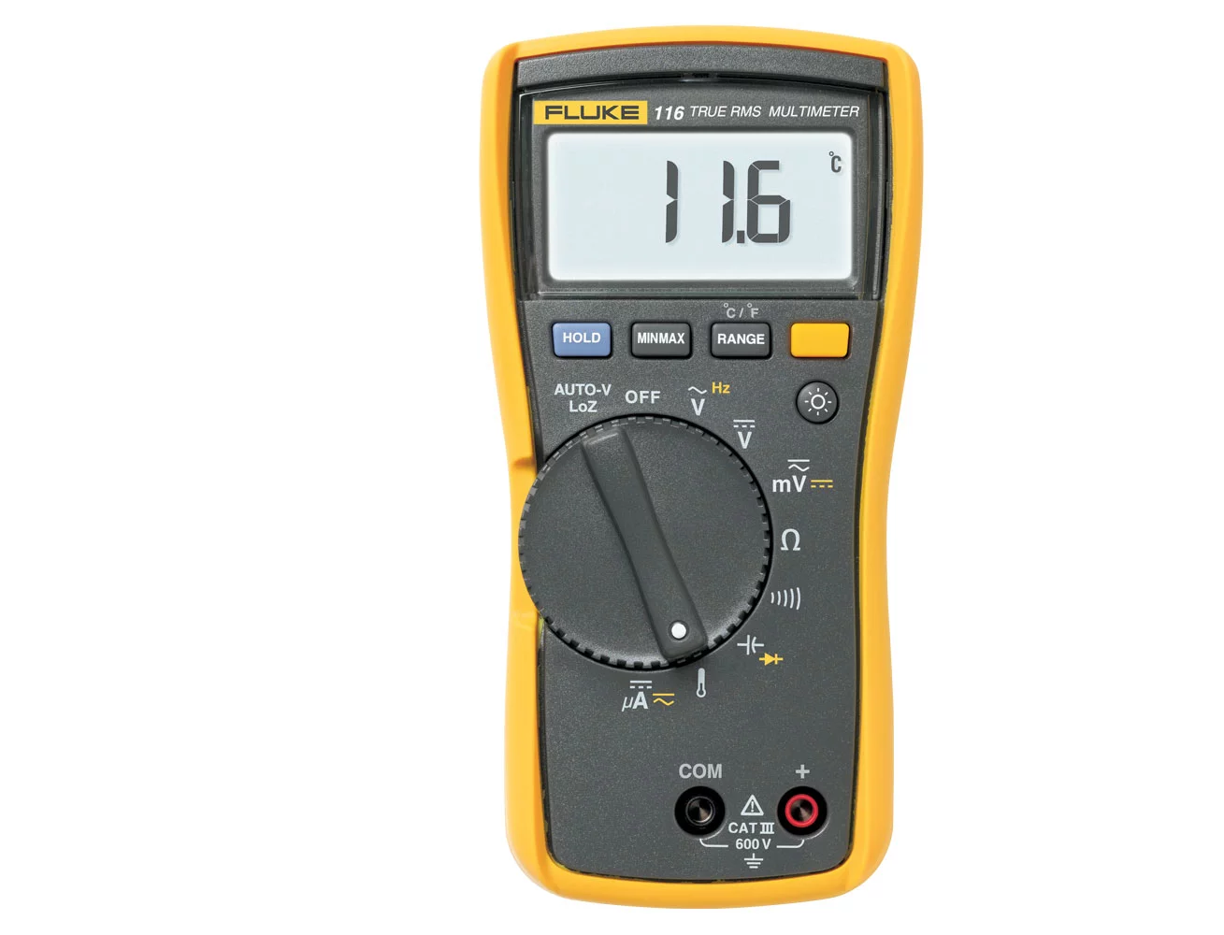
Measuring
DC Voltage
Resistance
Current
Multimeter Basics
Continuity
Notes:
Mainly be measuring DC voltage - this comes from batteries
Continuity is measuring the resistance between two points - for example if you want to check if you’re shorting power and ground

Slide 28
Ohm’s Law
I = V/R
Current (I): net flow of charged particles, Amperes(A)
Voltage (V): electric field potential difference, Volts(V)
Resistance (R): difficulty for current to pass through, Ohms(Ω)
Notes:
Ohm’s law relates current to voltage
Current is the rate of flow of electrically charged particles (measured in amps)
Voltage is the difference in electric potential between two points
Resistance is opposition to flow of current

Slide 29
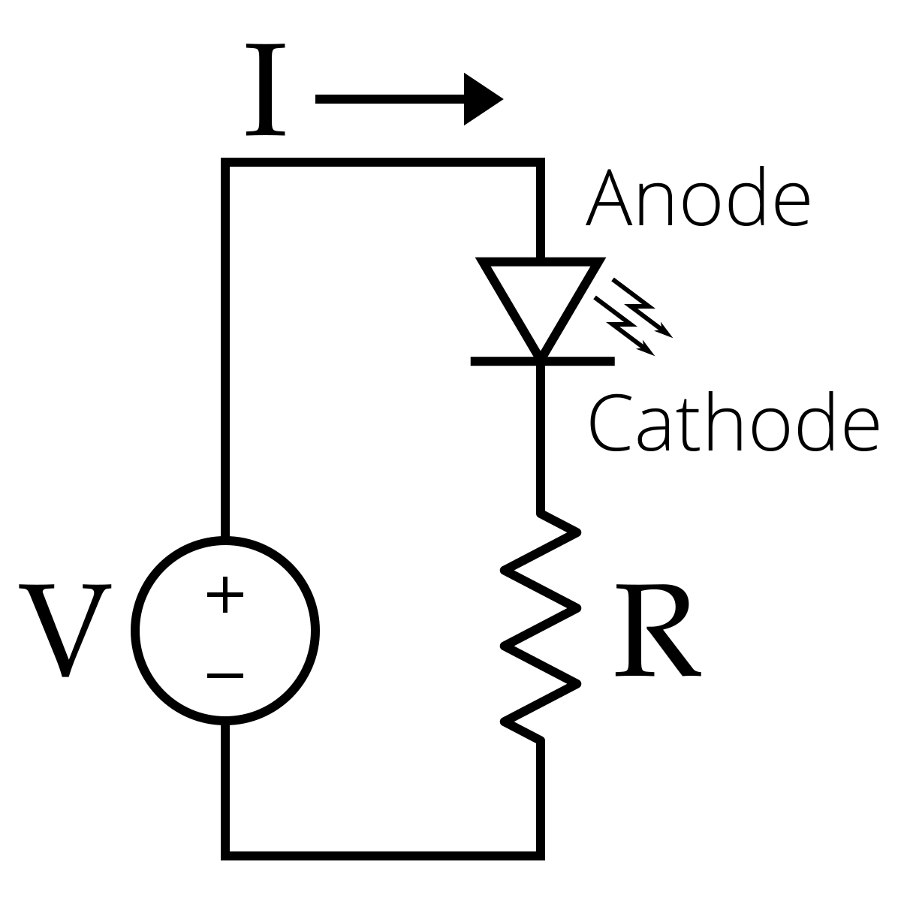
Example circuit
Current flows through the circuit allowing the LED to turn on

Slide 30
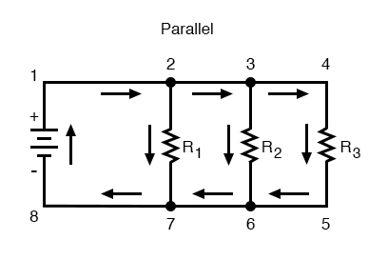
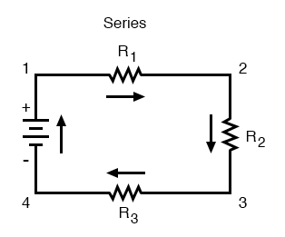
Parallel and Series Circuits
Parallel
Series
Constant voltage drop for each path
Current is the same everywhere in the circuit

Slide 31
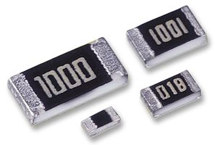
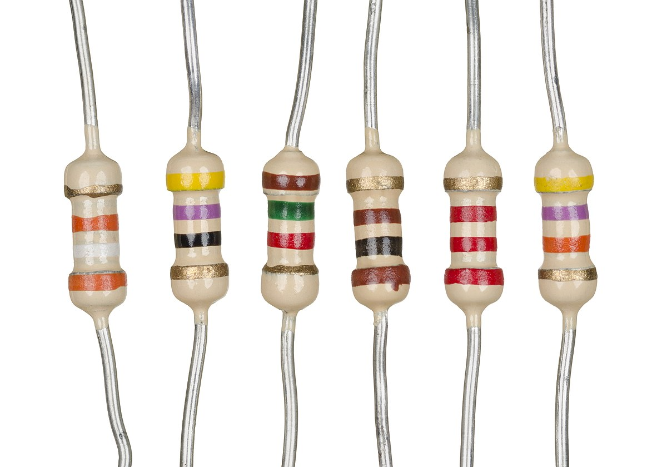
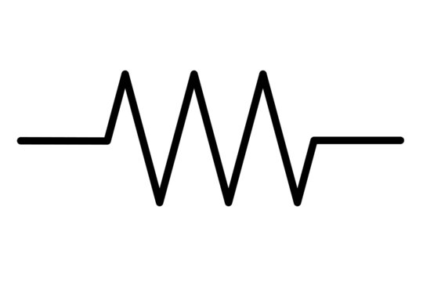
Resistor
Resistance measured in Ohms (Ω)
Reduces current flow
Converts electrical energy to heat

Slide 32
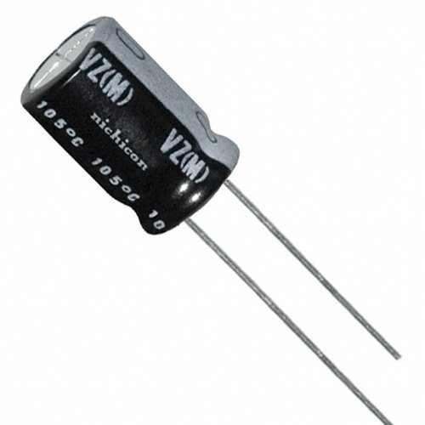
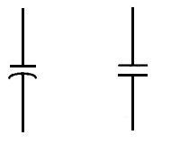
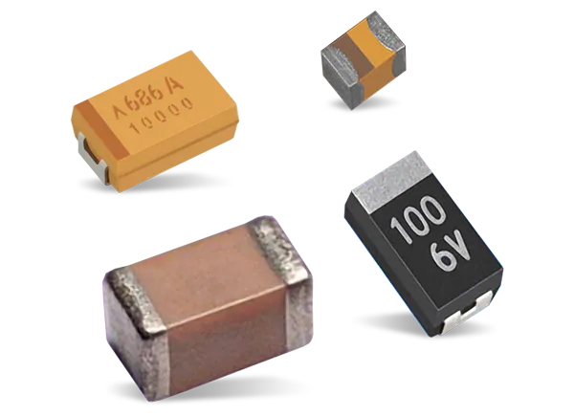
Capacitor
Measured in Farads (F)
Stores energy as an electric field between two charged plates
Uses:
Power Source
Smoothing voltage signals

Slide 33
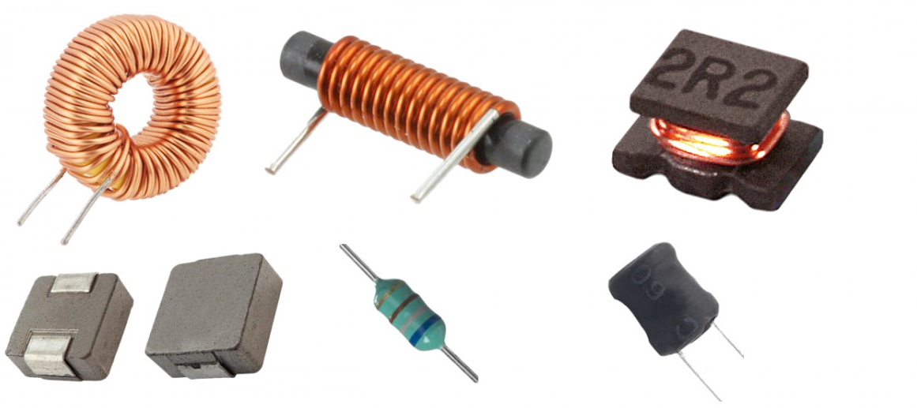
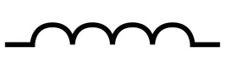
Inductor
Measured in Henry (H)
Stores energy as a magnetic field in a coil
Uses:
Smoothing current
Electromechanical parts (solenoids, relays)

Slide 34
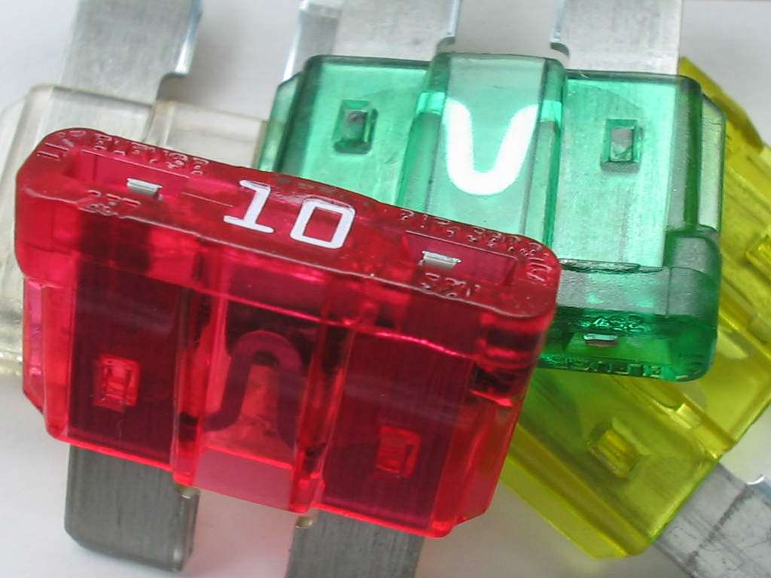
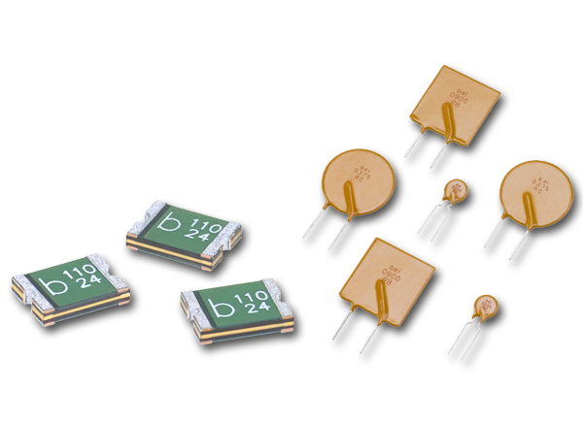
Fuse
Safety device which blows when too much current flows through it

Slide 35
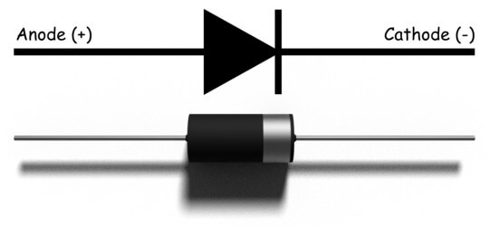
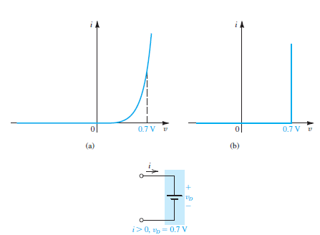
Diode
Conducts current in one direction
CVD Model: Assume diode conducts infinite current at constant voltage
Notes:
Resistors add resistance into a circuit - reducing current flow. Can also divide voltage.
Capacitors - stores electric energy, can charge and discharge, larger the capacitance the more it can store

Slide 36
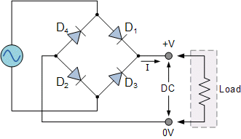
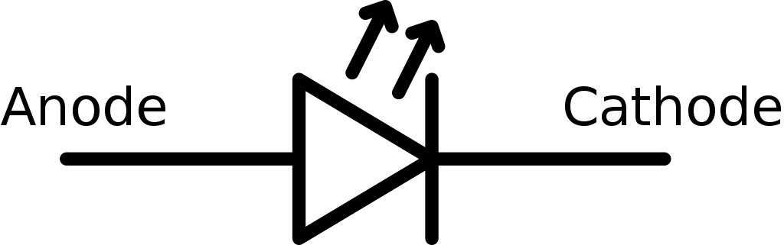
Diode
Uses:
Rectification
Reverse Polarity Protection
Light Emitting Diode

Slide 37
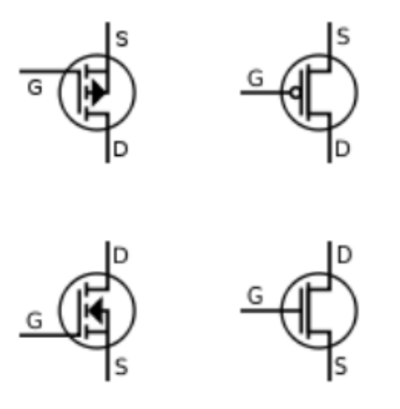
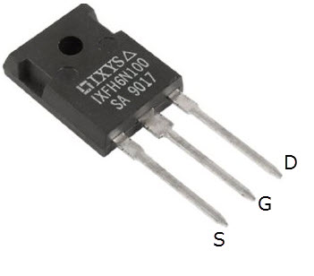
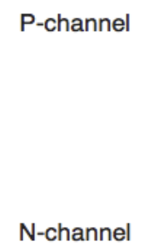
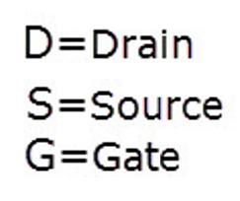
Transistor (MOSFET)
3 Terminal Component
Gate, Drain, Source
Voltage signal at gate controls current flow between Source and Drain
Acts as an electronic switch
Notes:
Resistors add resistance into a circuit - reducing current flow. Can also divide voltage.
Capacitors - stores electric energy, can charge and discharge, larger the capacitance the more it can store

Slide 38
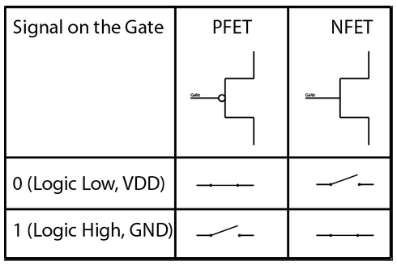

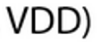
Transistor
Transistors “activate” when the gate-source voltage reaches the threshold
Two types: N- and P-Type
N-Type: source kept at GND
P-Type: source kept at VDD
Notes:
Resistors add resistance into a circuit - reducing current flow. Can also divide voltage.
Capacitors - stores electric energy, can charge and discharge, larger the capacitance the more it can store

Slide 39
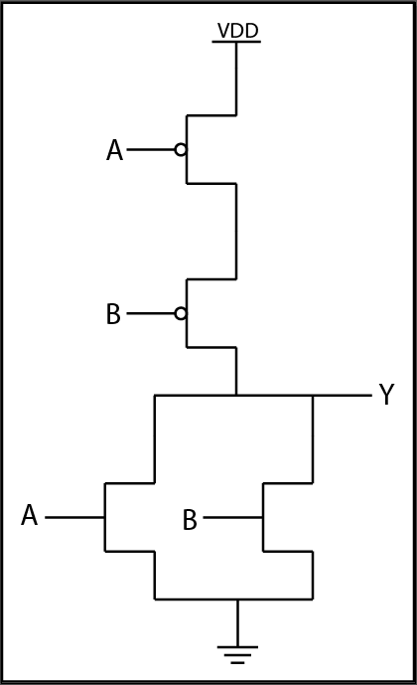
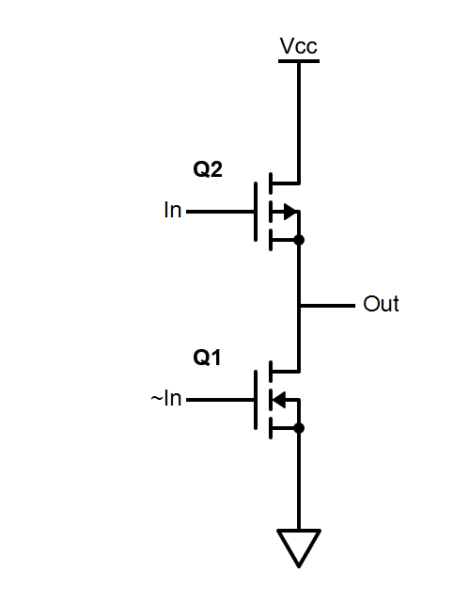
Transistor Uses
Digital Logic
Power Amplification

Slide 40
Kahoot
Test your knowledge
Notes:
https://create.kahoot.it/share/rj-electrical-training-week-0/973cf5ca-ec68-4c17-8e44-5514988696d2

